Slide 1

Nitrogen Isotopic Fractionation in Prestellar Core L43E
Reynier Nicole Squillace
Arizona Space Grant Consortium
Supervisor: Yancy Shirley

Slide 2
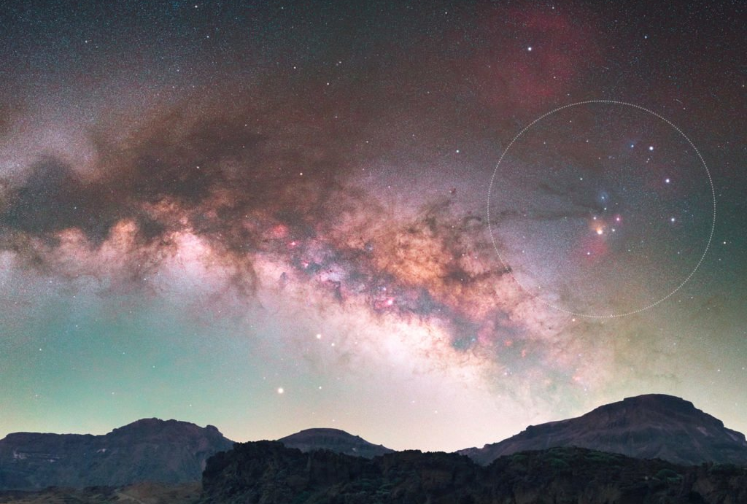
Prestellar Cores
Stage of stellar development before protostar
Temperatures several Kelvin above the Cosmic Microwave Background (2.75K)
Exist within molecular clouds
  Lynds 43 East
  Image source: AURORA Live

Slide 3
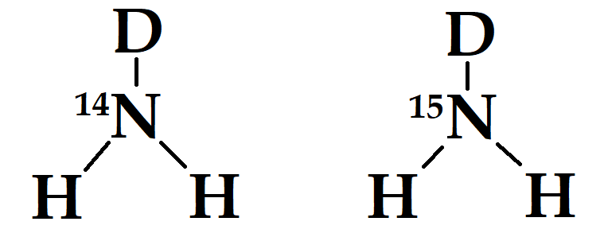
Nitrogen Fractionation
Over time, the populations of 15-Nitrogen build up
Ratios of 14-Nitrogen to 15-Nitrogen are generally found in the range of 330
Star-forming regions and materials (Sun’s photosphere, comets, protostars, etc) show much higher ratios
The processes behind this are not clear
Chemodynamical models do not predict this

Slide 4
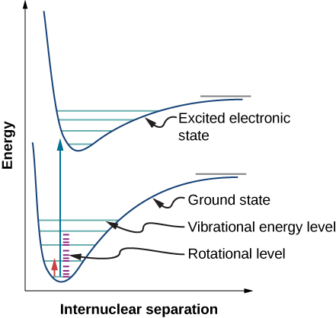
Molecular Spectroscopy
Atoms have quantized energy levels depending on electronic configuration
Molecules can move in a variety of ways which divide electronic levels into sub-levels:
  Vibrational modes
  Rotational modes
  Image source: Chemistry LibreTexts

Slide 5
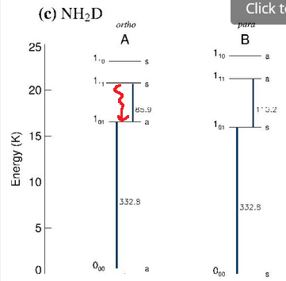

Molecular Spectroscopy
Each of these rotational levels is further divided into a “hyperfine structure”
  Minute differences in energy states due to symmetry, spin dynamics, etc
Every time the molecule transitions between energy states, a photon is released with energy that balances the molecule’s change in energy
This results in an identifiable spectrum
Boltzmann Distribution at excitation temperature
$$\frac{n_{u}}{n_{l}}=\frac{g_{u}}{g_{l}}e^{−\frac{hν}{kT_{ex}}}$$
Image source: Deuteration of ammonia in the starless core Ophiuchus/H-MM1, Harju et al.

Slide 6
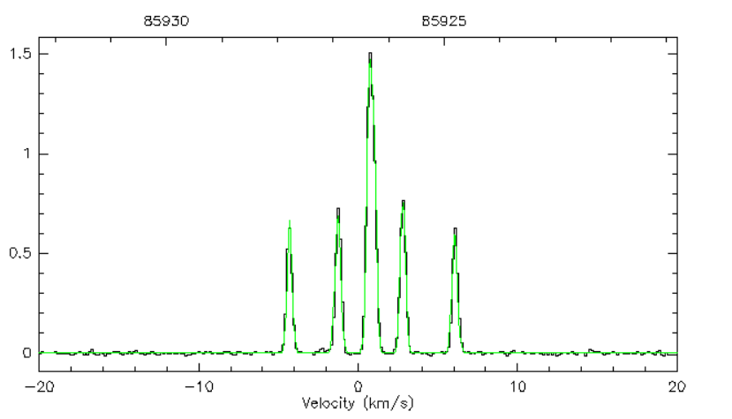

Slide 7
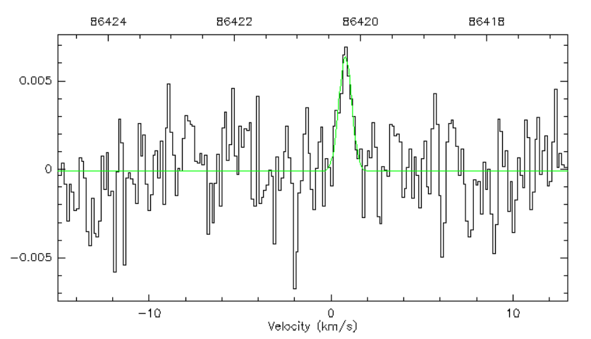

Slide 8
Methodology
We use the spectra of 14NH2D and 15NH2D to derive column density
  “Column density” = number of molecules in a compression of a volume into an area
Column density derivation depends on excitation temperature of molecule
  “Excitation temperature” = temperature at which Boltzmann ratio predicts the observed energy populations
Methods differ according to optical depth
  “Optical depth” = degree to which light transmits through a medium

Slide 9


Column Density Derivation
Optically thin case (15NH2D):
$$N_{total}∝F_{thin}\left(T_{ex}\right)∗I$$
Area under the spectrum
Optically thick case (14NH2D):
Optical depth
$$N_{total}∝F_{thick}\left(T_{ex}\right)∗τ_{ν}∗∆v$$
Spectral width (FWHM)

Slide 10
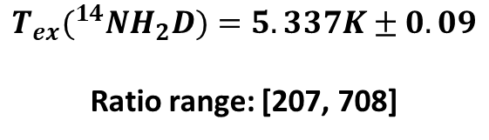
Results
$$T_{ex}(^{14}NH_{2}D)=5.337K±0.09$$
Ratio range: [207, 708]

Slide 11
Conclusion
We cannot say definitively whether fractionation is occurring
  Our result could be consistent with the global average
There have been less than six prestellar cores evaluated for 14N/15N
Much more research is needed to understand the fractionation processes at work in the universe
Our understanding of fractionation can be improved by constraining parameters
  Filling fraction of telescope
    Future area of research

Slide 12
Acknowledgements
Dr. Yancy Shirley, Department of Astronomy and Steward Observatory
Michelle Coe and Dr. Chandra Holifield Collins, Arizona Space Grant Consortium
Brooke Carruthers, Hayley Limes, and Jacob Magnusson, Arizona Space Grant Consortium
Arizona Space Grant Consortium
NASA
University of Arizona
Arizona Radio Observatory

Slide 13
For 14NH2D, rotational modes are described by 3 quantum numbers
  J, Ka, Kc
We are looking at J=1 states
  Total rotational energy is constant, method of rotation changes
Rotational transitions undergo hyperfine splitting
  14N: s = 1
  1H: s = ½ (two 1H atoms)
  2D: s = 1
Transition rules for spin interaction result in 6 hyperfine transitions within the rotational transition
  Only 5 can be independently resolved
These transitions are themselves split into hyperfine transitions by the spin properties of the 2D
  31 lines total
  Only detectable through broadening, not individually resolved
15NH2D is a lot simpler– only has the 2D hyperfine structure
  Also not resolvable

Slide 14
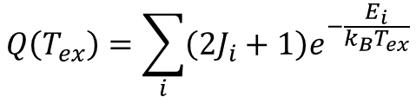
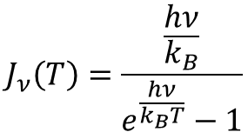
Column Density Derivation
Planck function in temperature units:
$$J_{ν}\left(T\right)=\frac{\frac{hν}{k_{B}}}{e^{\frac{hν}{k_{B}T}}−1}$$
Partition function:
$$Q\left(T_{ex}\right)=\sum_{i}^{ }{\left(2J_{i}+1\right)e^{−\frac{E_{i}}{k_{B}T_{ex}}}}$$
…evaluated across all levels in the hyperfine structure.

Slide 15
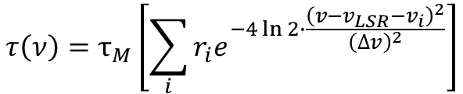
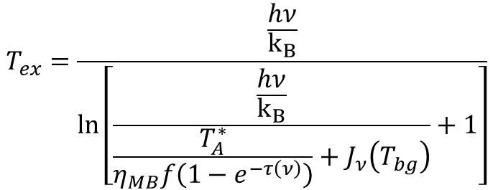
Column Density Derivation
We can derive excitation temperature for the optically thick case:
$$T_{ex}=\frac{\frac{hν}{k_{B}}}{ln\left[\frac{\frac{hν}{k_{B}}}{\frac{T_{A}^{∗}}{η_{MB}f\left(1−e^{−τ\left(ν\right)}\right)}+J_{ν}\left(T_{bg}\right)}+1\right]}$$
…where:
$$τ\left(ν\right)=τ_{M}\left[\sum_{i}^{ }{r_{i}e^{−4\ln{2}∙\frac{{\left(v−v_{LSR}−v_{i}\right)}^{2}}{{\left(∆v\right)}^{2}}}}\right]$$
…evaluated across all levels in the hyperfine structure.

